Slide 1
以筆跡偵測字母輸入
Team 14
0616309 王祥任
0616031 李昀奇
0616098 黃秉茂

Slide 2
Outline
Motivation
Data Collection
Data Preprocessing
Model
KNN
Random Forest
SVM
ANN
Conclusion

Slide 3

Motivation
A

Slide 4
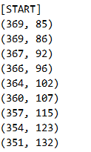
Data Collection - Tool
自己寫的小畫家
紀錄路徑
大寫英文字母

Slide 5

Data Collection
About 760 records
Each letter has about 25 records.

Slide 6
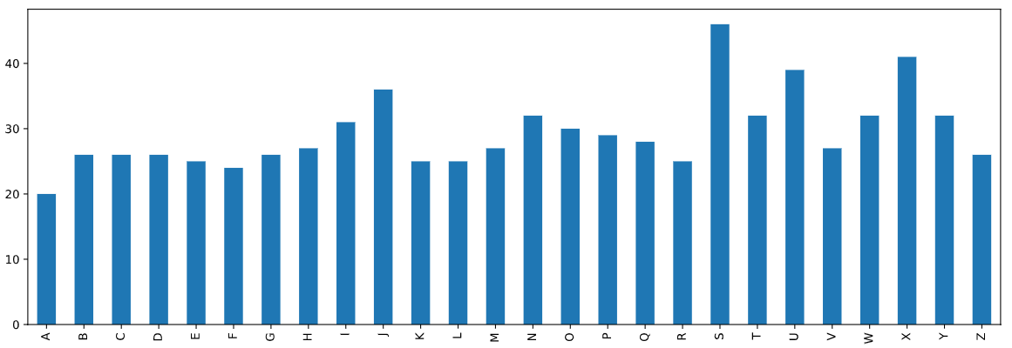
Data Collection - Statistics

Slide 7
Data Preprocessing - Problem
Number of Dimension
The number of samples of each stroke is different.
The number of strokes of each letter is different.

Slide 8
Data Preprocessing - Features of each letter
The upper bound of the number of strokes of each letter is 4.
Zero-padding for those # of strokes is lower than 4.
[Letter][Stroke#1][Stroke#2][Stroke#3][Stroke#4]

Slide 9
Data Preprocessing - Features of each stroke
角度
位移長度
路徑長度
路徑長相較位移長之倍率
該筆劃之起點相較第一筆劃起點之距離
斜率於X軸上變號之次數
斜率於Y軸上變號之次數

Slide 10
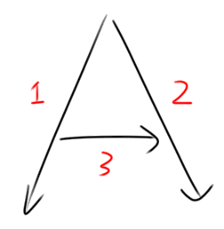
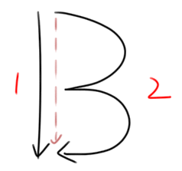
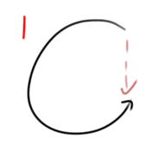
Data Preprocessing - Stroke

Slide 11
Data Preprocessing - Stroke
One-stroke letter is hard to identify by feature 1 to 5.
Feature 6 and feature 7 to identify the change of slope.
C S O U

Slide 12
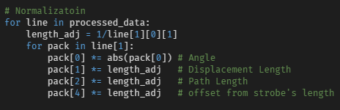
Data Preprocessing - Enhancement
Angle is the most important feature, so sign-square itself to enhance it.

Slide 13
Data Preprocessing - Normalization
The size of bounding box of each record may be different.

Slide 14
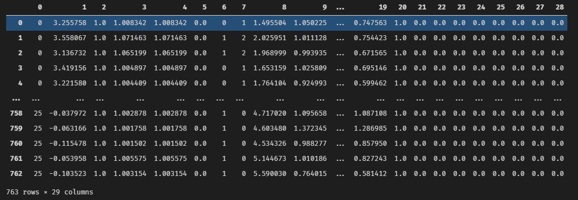
Data Preprocessing - Result

Slide 15
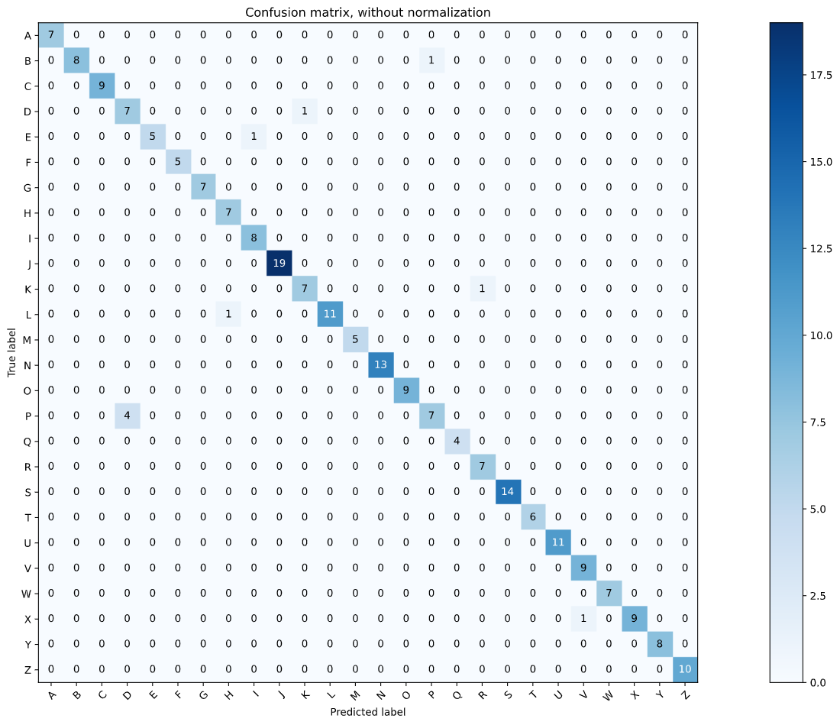
Model - KNN
Accuracy : 0.96
B-P
D-K
E-I
P-D
K-R

Slide 16
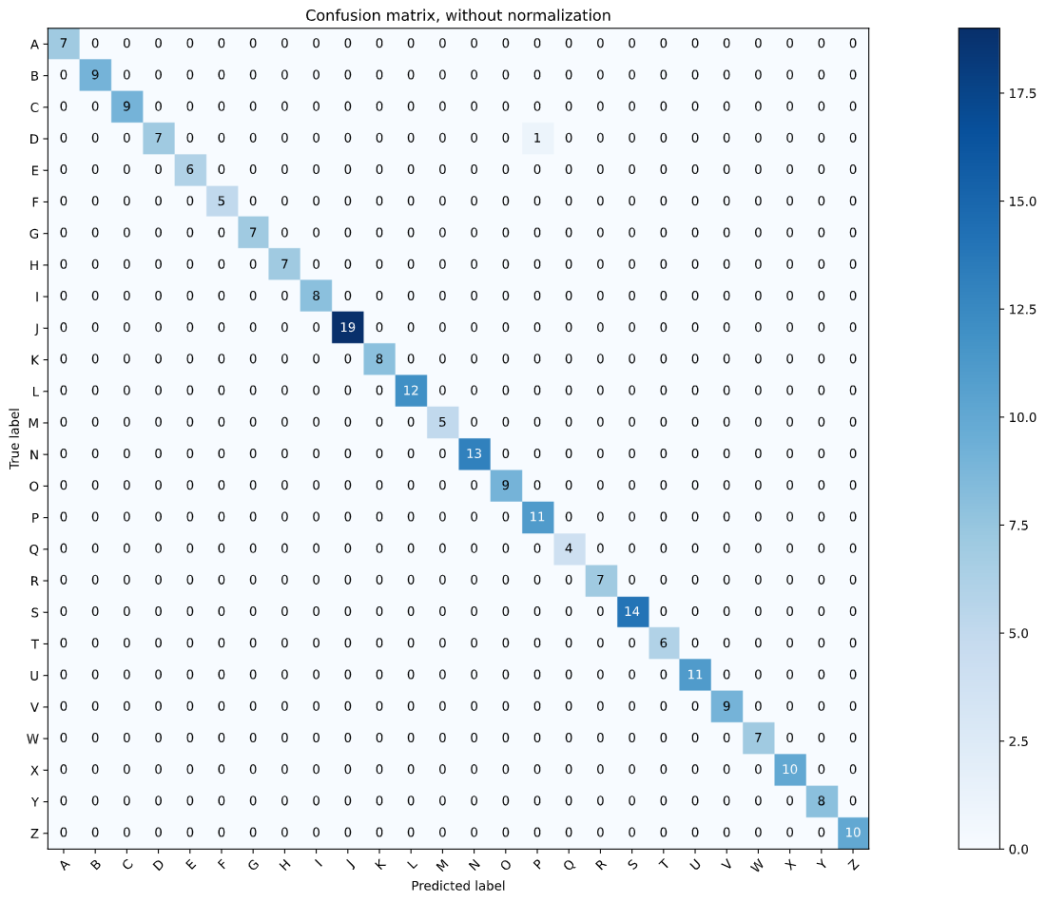
Model - Random Forest
Accuracy : 1.00
D-P

Slide 17
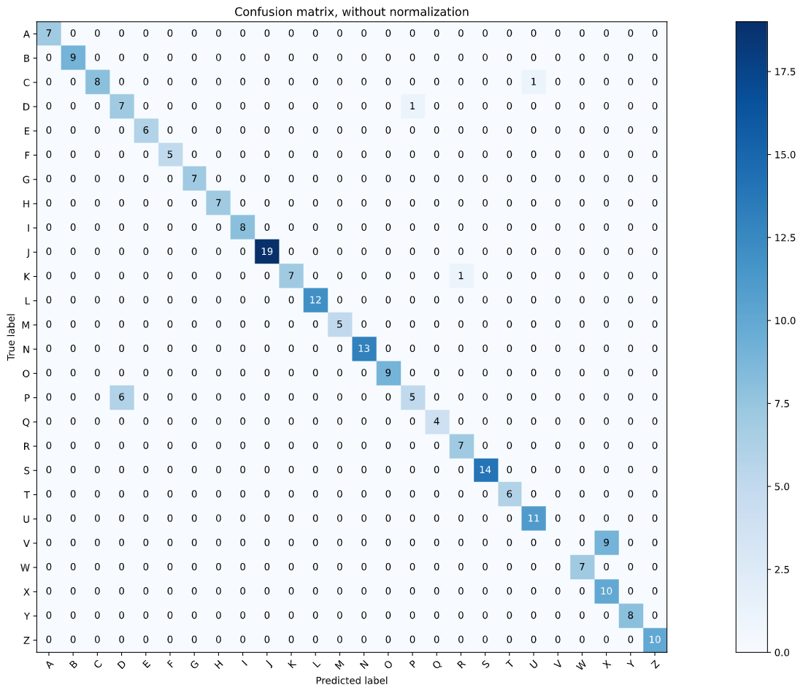
Model - SVM
Accuracy : 0.92
D-P
K-R
C-U
V-X

Slide 18
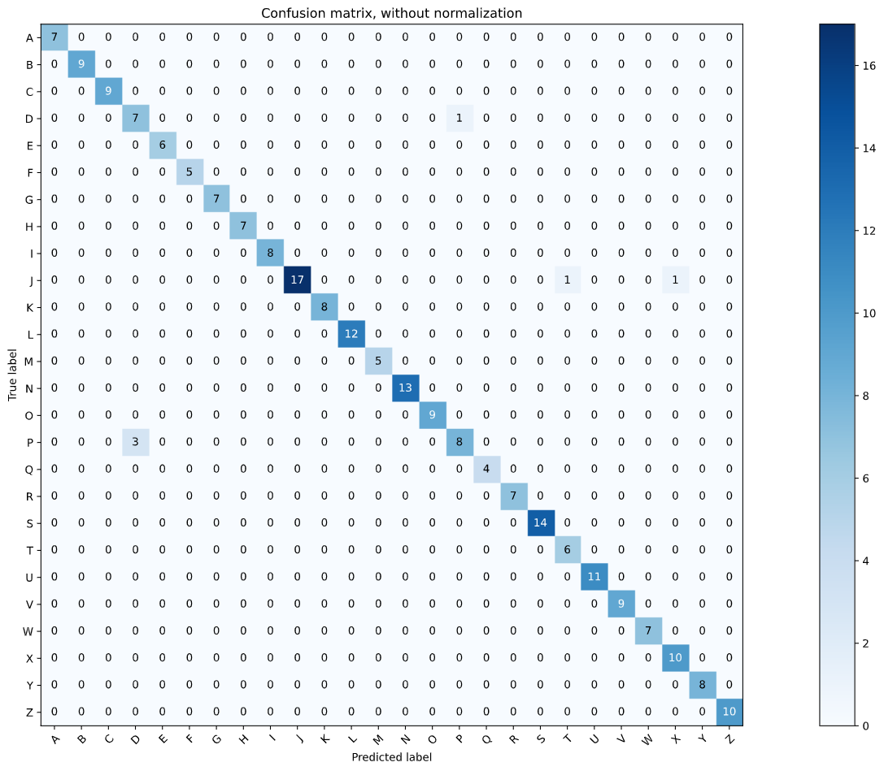
Mondel - ANN
Accuracy : 0.97
D-P
J-T
J-X

Slide 19
Conclusion
Only need 28 features for each data
Accuracy is high
D-P is hard to identify
Not very general
Highly depends on user

